Slide 1
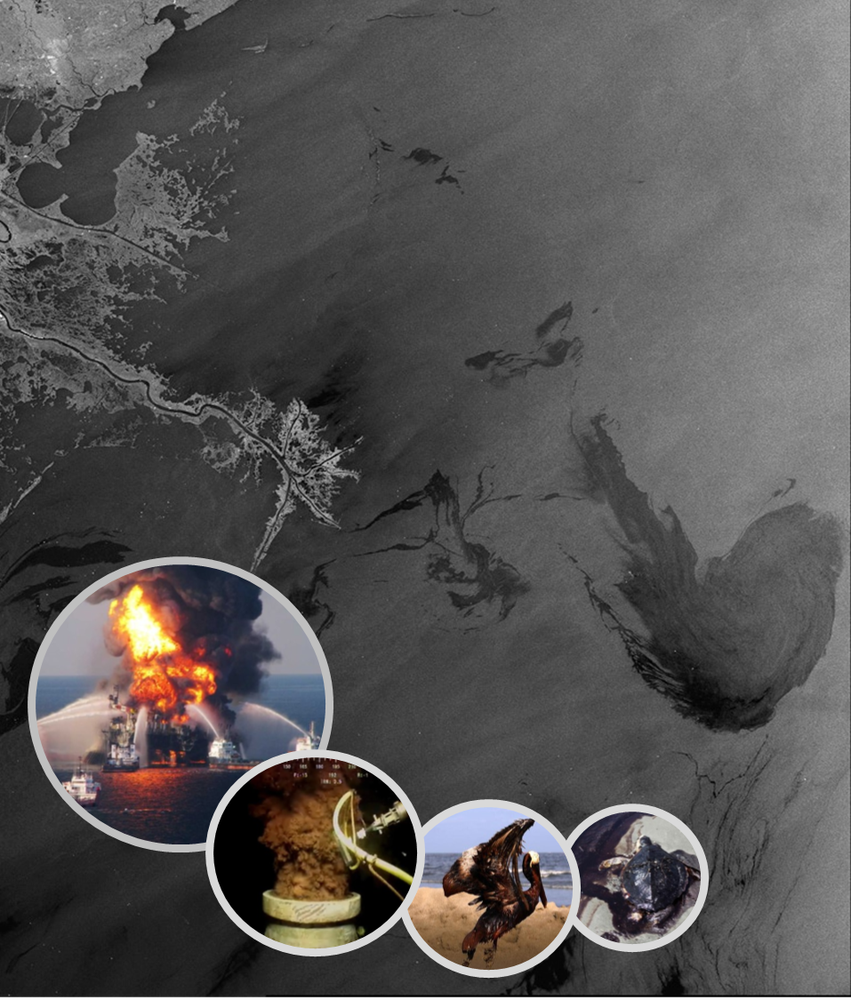

OIL SPILL DETECTION EMPLOYING SAR DATA AND MACHINE LEARNING
FACULTY OF GEO-INFORMATION SCIENCE AND EARTH OBSERVATION - UNIVERSITY OF TWENTE
GROUP 8:
Abdul-raheem Umar
Kaushal Kishor
Patrícia C. Genovez
Rezaul Bhuiyan
10 November 2023

Slide 2
Agenda
Introduction
Data Set
Methodology
EDA
ML: Random Forest
DL: DeepLabV3+
DL: U-Net
Conclusion

Slide 3
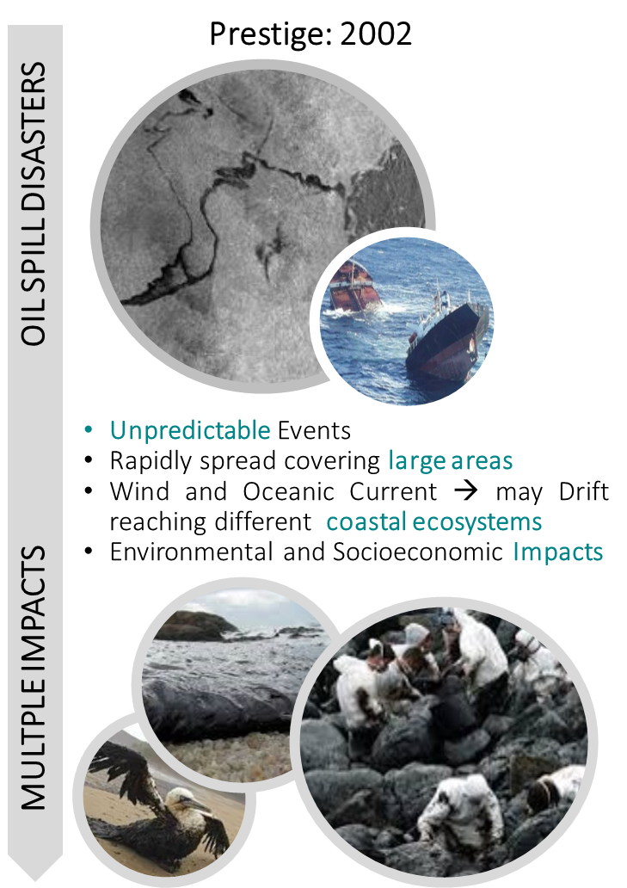
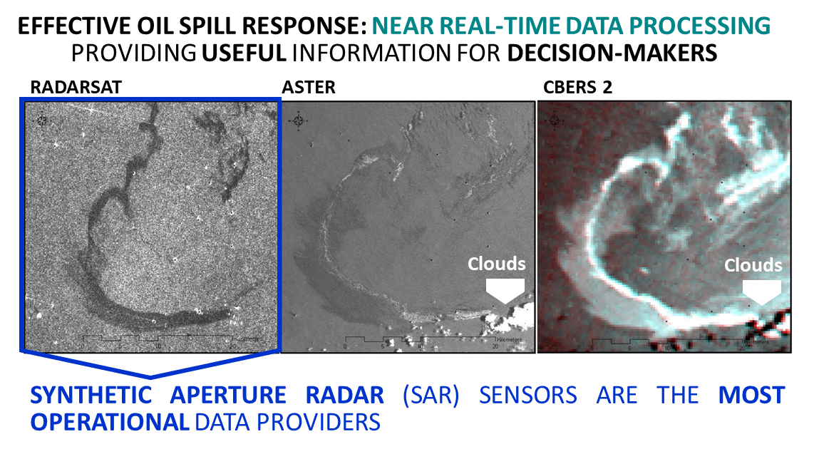
INTRODUCTION AND BACKGROUND
Monitor Remote Oceanic regions with difficult access
Wide Swaths: Covering Large Areas
Active Sensor: Day and Night Acquisition
Operate in all Weather Conditions
Near Real Time (NRT) Delivery
Oil Spills = Dark Spots
Main Limitation: False Alarms
Notes:
Oil spills are unpredictable events that can occur anywhere at anytime
On the sea surface oils slicks rapidly spreads covering large areas
Depending on the wind and oceanic currents slicks can drift and reach coastal ecosystems
Causing different environmental and socio-economic impacts
For an effective oil spill response, a NEAR REAL TIME DATA PROCESSING IS NEEDED TO PROVID USEFUL INFORMATION FOR THE DECISION MAKERS
It is possible detect oils spills in different spectral ranges, optical, thermal, NIR, UV …. However Synthetic Aperture Radars area the most operational data providers
Allowing to monitor Remote offshore areas with difficult access
Covering large areas
During the day and the night
Operating in all weather conditions
Delivering data in near real time
IN SAR DATA OIL SPILS ARE DETECTED AS DARKS SPOTS DUE TO THE SPECULAR REFLECTION
Main limitation is that other phenomena are also BE detected as dark spots - generating false alarms

Slide 4
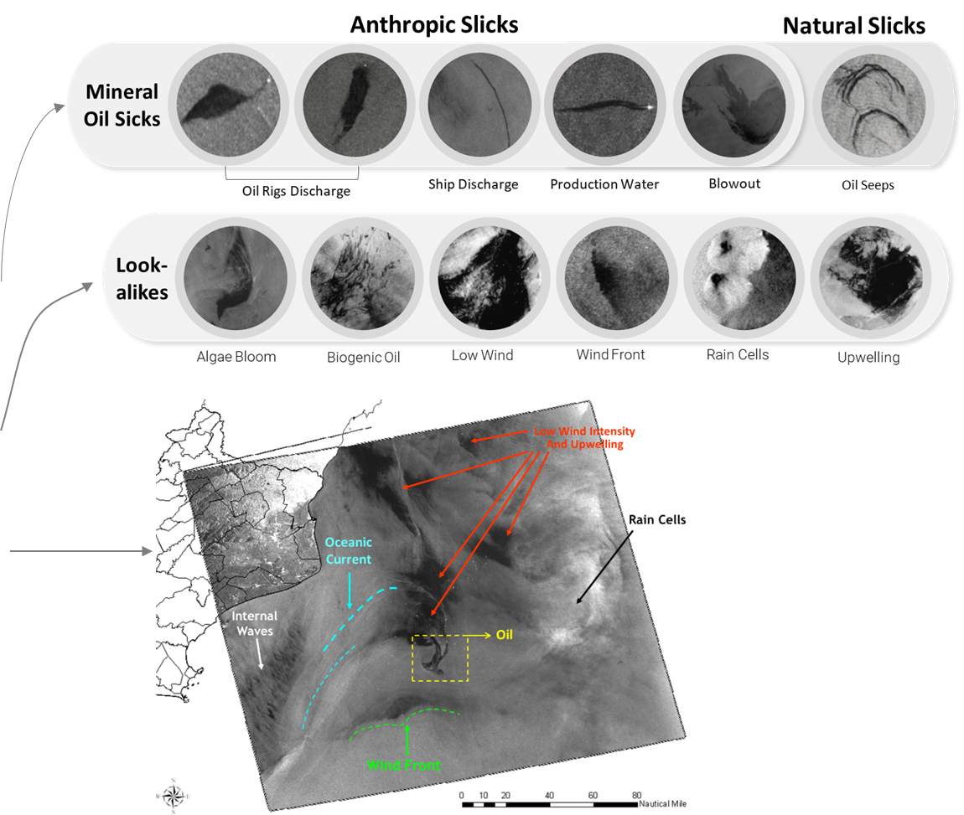
WHY MACHINE LEARNING & DEEP LEARNING?
Oil Spill Detection and Discrimination is Challenging:
SAR Data Complexity: Speckle Noise (Multiplicative Noise), Background Noise, Different Statistical Distributions - Non-linear (Data Format)
Scale and Shape: Different Dimensions and Geometries depending on the type, the volume and the source of the oil slicks
Classes Ambiguity: other meteo-oceanographic events can also be detected as Dark Spots = False Alarms
SAR Scene Complexity: simple scenarios = well-defined and easy detectable Oil Spills, as well as complex scenarios with multiple dark spots.
Big SAR Data: Humanly Unfeasible process and interpret huge amount of data operationally.
Notes:
SAR Data is Complex: Speckle Noise (Multiplicative Noise), Noise Equivalent Sigma Zero Noise (NESZ), Different Statistical Distributions - non-linear (Complex: MCG; Intensity: Exponential; Amplitude: Rayleigh)
Shape and Scalability: Different dimensions and geometries depending on the type, the volume and the source of the oil slicks, as well as on the wind and currents
Classes Ambiguity: other different meteo-oceanographic events are also detected as dark spots and generate false alarms
SAR Scene Complexity: simple scenarios with well-defined and easy detectable dark spots, as well as complex scenarios with multiple dark spots and meteo-oceanographic conditions.
Big SAR Data: Unfeasible for human processing and interpretation (Subjective: depends on the background of the interpreter)

Slide 5

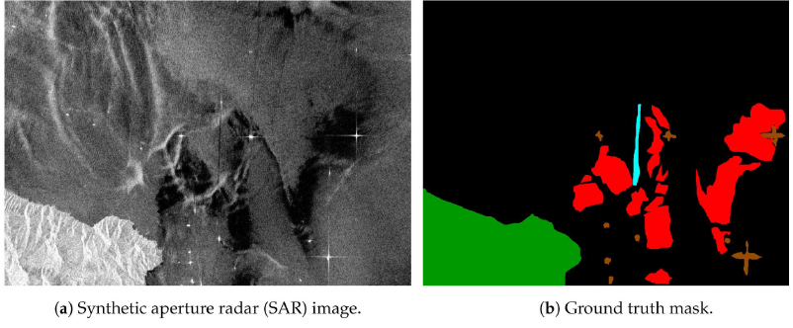
DATA AVAILABILITY AND POTENTIAL CHALLENGES
Objective: Train, Test, and Validate ML models to discriminate Oil Spills from Look-Alikes using SAR data.
Benchmark: Oil Spill Detection Dataset
Image Size = 1250
Number of Samples and Classes:
1,112 samples
5 classes:
0. Sea Surface
1. Oil Spill
2. Look-alike
3. Ship
4. Land
650
Synthetic Aperture Radar
Ground Truth Mask
Sentinel-1: Polarization - VV; Spatial Resolution - 10 m; Speckle Reduction - Median Filter 7x7
SAR image subsets: 1250 x 650 pixels
Ground Truth: Labels
OSD Dataset:
Challenges: Classes Imbalance, Ambiguities, Adjust Codes to the Dataset, Hyperparameter Tuning
Krestenitis, M., Orfanidis, G., Ioannidis, K., Avgerinakis, K., Vrochidis, S., & Kompatsiaris, I. (2019). Oil spill identification from satellite imagedeep neural networks. Remote Sensing, 11(15), 1762.
Krestenitis, M., Orfanidis, G., Ioannidis, K., Avgerinakis, K., Vrochidis, S., & Kompatsiaris, I. (2019). Early Identification of Oil Spills inSatellite Images Using Deep CNNs. In International Conference on Multimedia Modeling (pp. 424-435). Springer, Cham.

Slide 6
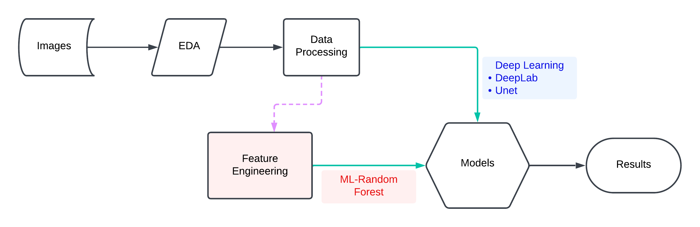
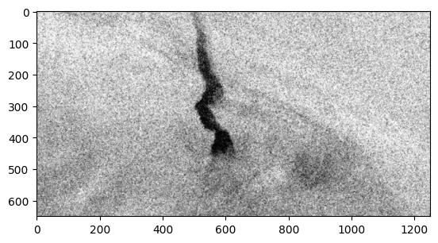
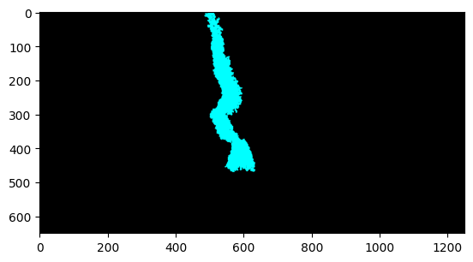
METHODOLOGIES: TRADITIONAL ML AND DL
320x320
GLCM-contrast
Erosion
(Kernel)Filtering
Class Balancing

Slide 7
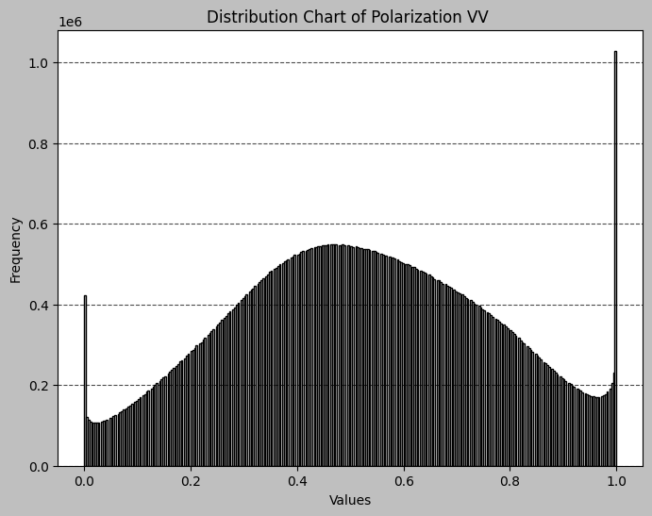
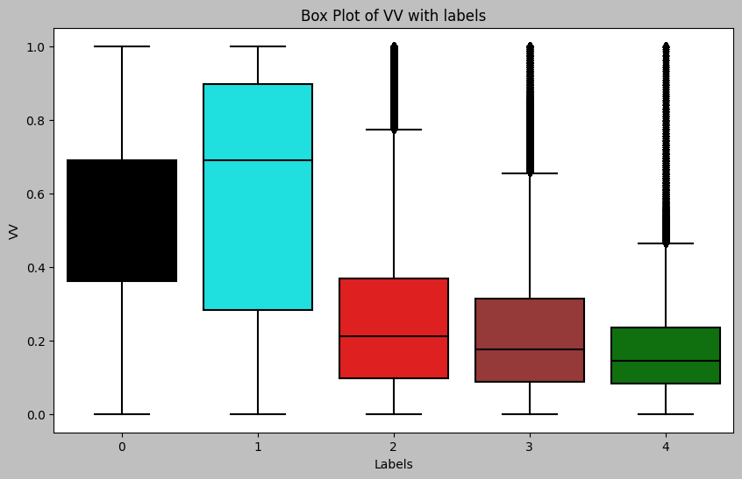
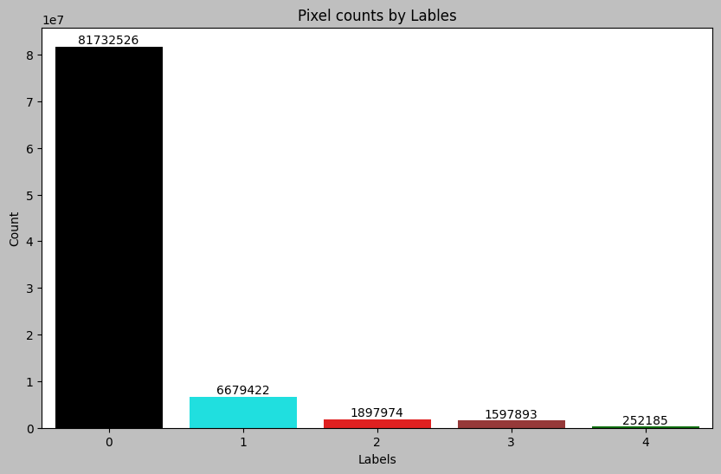
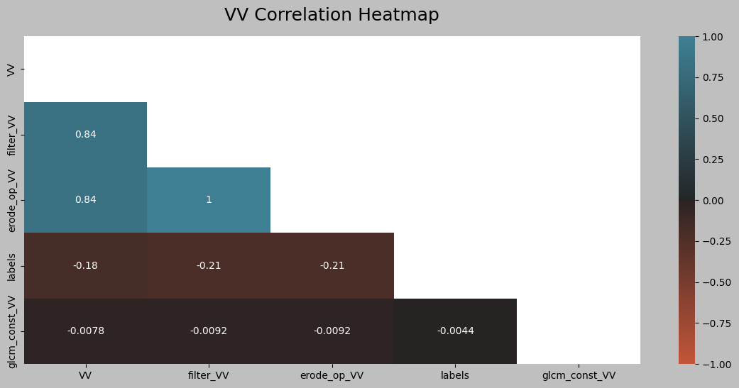
Exploratory Data Analysis

Slide 8
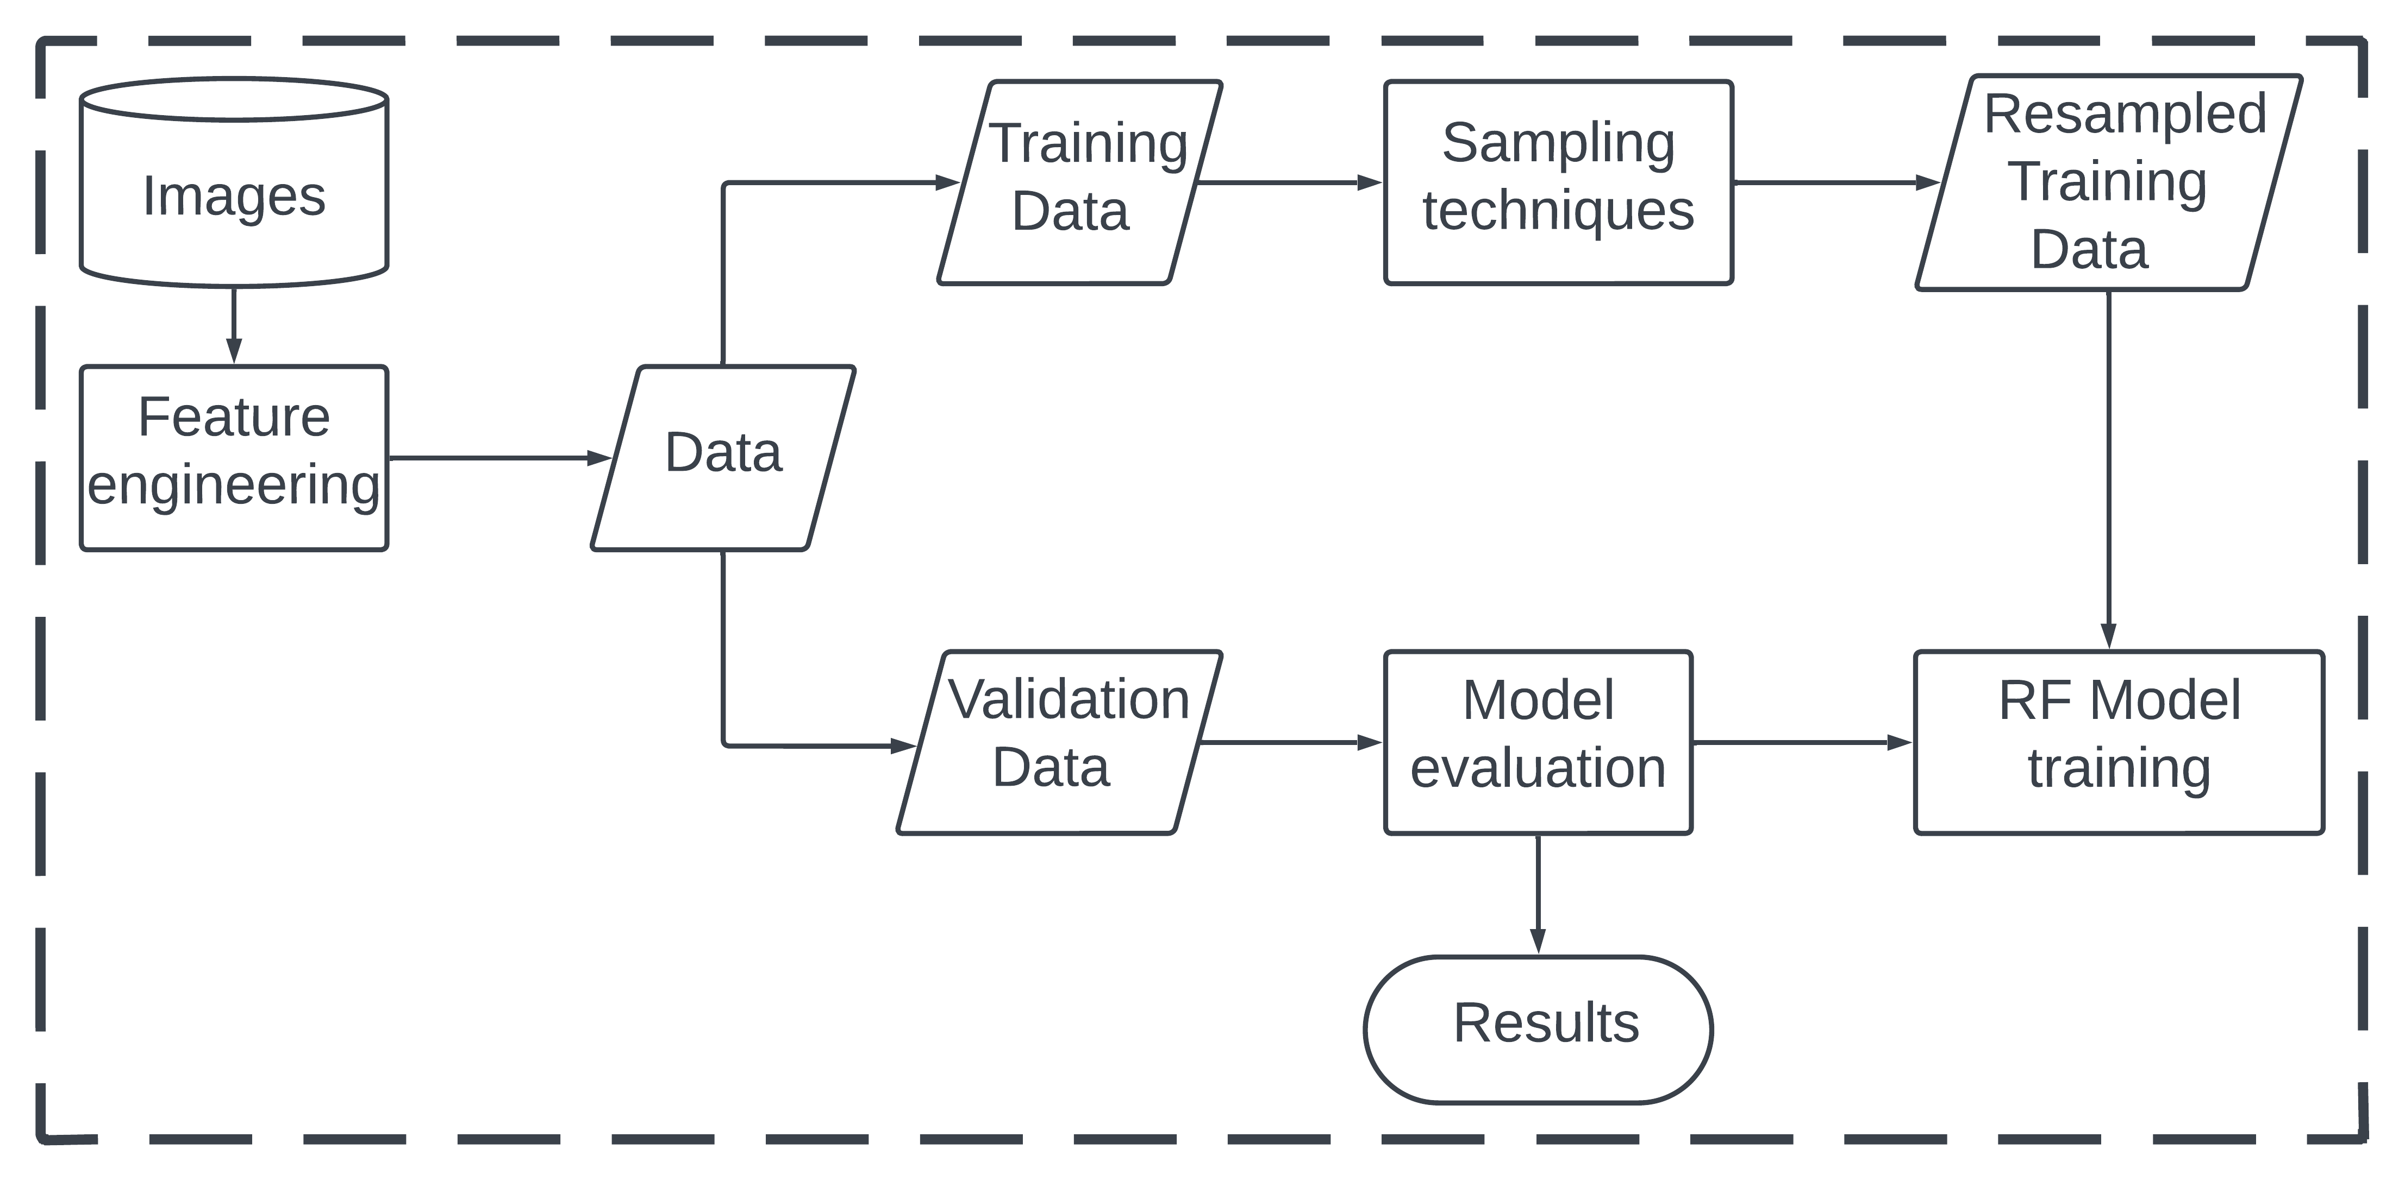
RANDOM FOREST MODEL IMPLEMENTATION

Slide 9
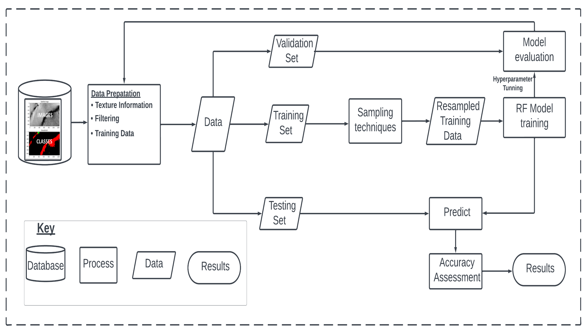
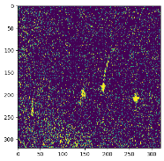
RANDOM FOREST MODEL IMPLEMENTATION
Dataset (1112):
Training: 900
Validation: 200
Test: 100
Hyperparameters:
Number of trees:200
Max depth: 5

Slide 10
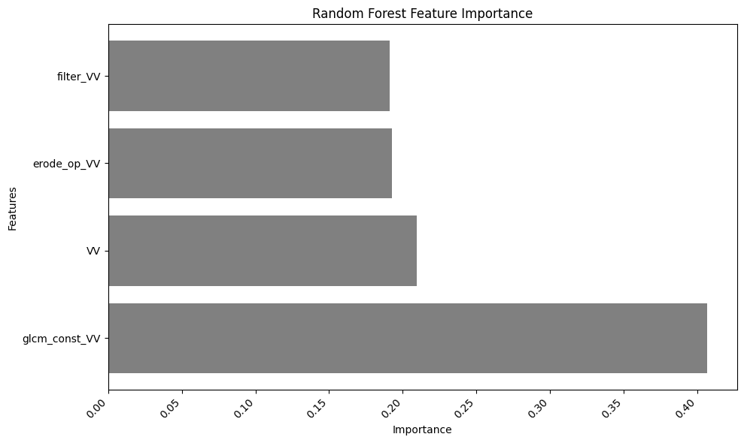
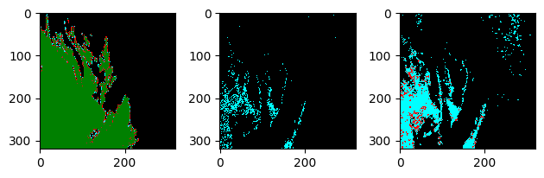
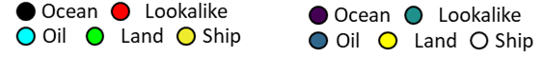
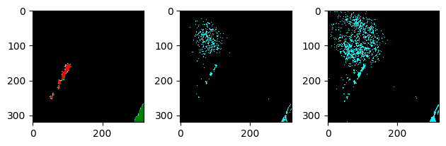
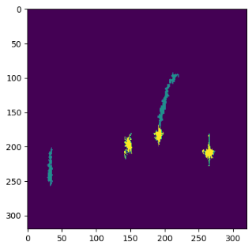

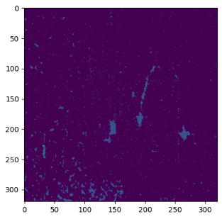
RANDOM FOREST MODEL RESULTS
Overall Accuracy
Sampling | VV + Texture | VV + Texture + Filters
Down | 0.40 | 0.42
Up | 0.40 | 0.41
Balanced | 0.868(0.13) | 0.877(0.15)
*IOU​
Classification Report: Balanced model
Class | Precision |  | Recall |  | F1-Score |  | Support
Sea | 0.92 | 0.94 | 0.94 | 0.94 | 0.93 | 0.94 | 9337961 | 9337961
Oil | 0.32 | 0.37 | 0.38 | 0.47 | 0.34 | 0.42 | 816494 | 816494
Look | 0.22 | 0.32 | 0.00 | 0.19 | 0.00 | 0.23 | 154361 | 154361
Ship | 0.04 | 0.02 | 0.00 | 0.00 | 0.00 | 0.00 | 96344 | 96344
Land | 0.00 | 0.02 | 0.00 | 0.00 | 0.00 | 0.00 | 39640. | 39640
Original label
VV + Texture
VV + Texture + Filters

Slide 11
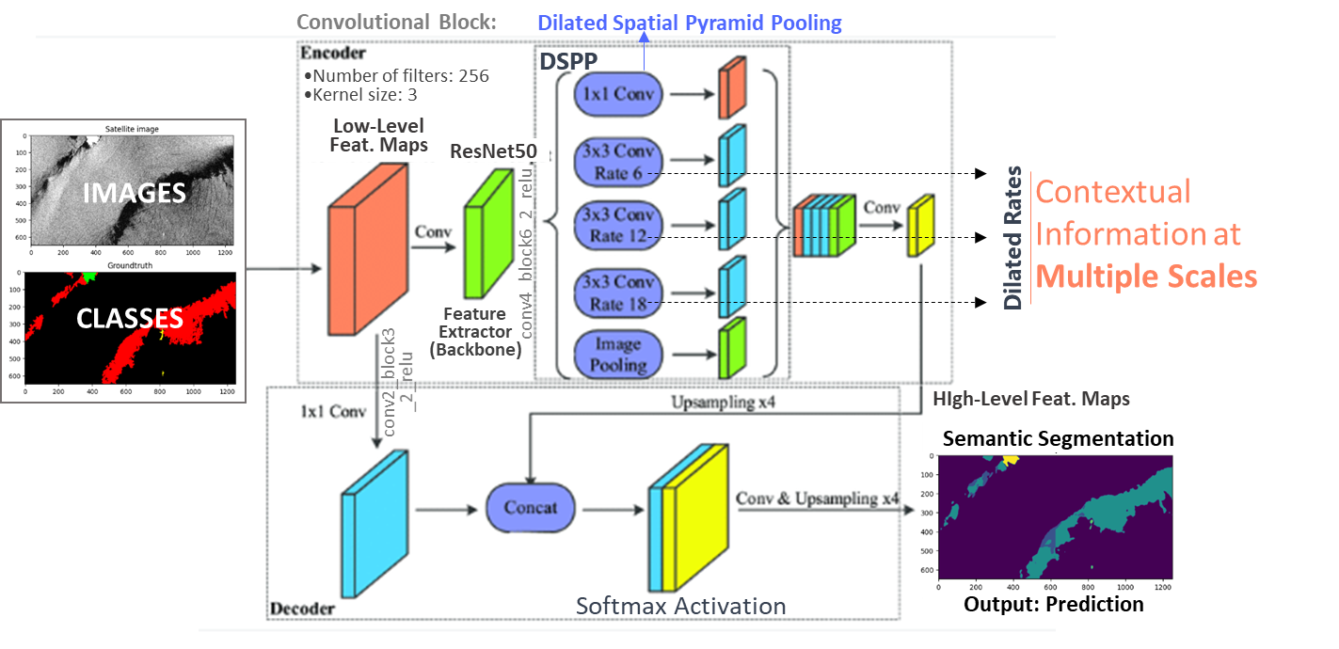
DEEPLABV3+: IMPLEMENTATION
DeepLabV3+ model Architecture for Semantic Segmentation
Same Configuration used in the Dataset’ Paper:
Training: 1002
Test: 110
Parameters:
Epochs = 100
Activation Function = ReLU
Batch Normalization
Loss Function = Cross-entropy
Optimizer = Adam
Learning Rate = 5 x 10⁻⁵
Classification Assessment:
Overall Accuracy
Loss Curve
Error Rate Curve
Intersection over Union (IoU)
Batch Size = 12 Patch Size = 320

Slide 12
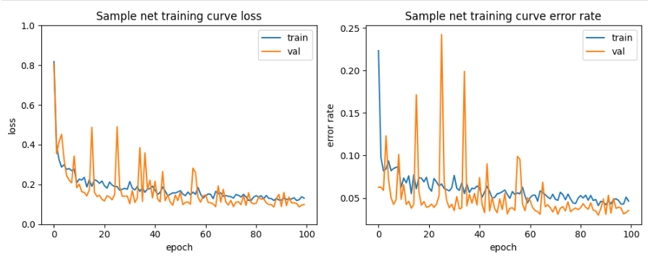
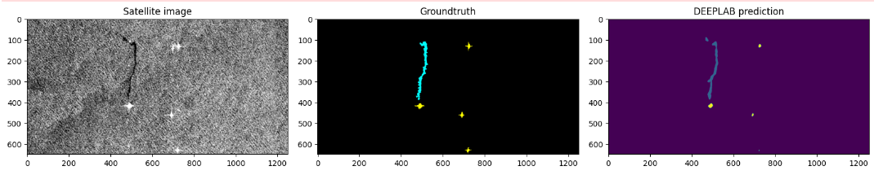
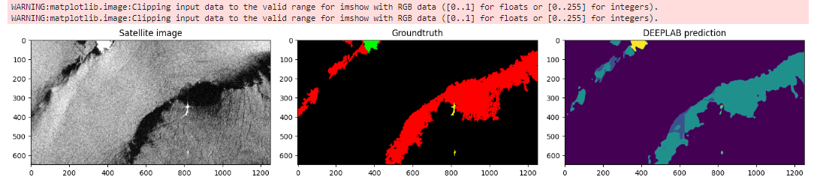
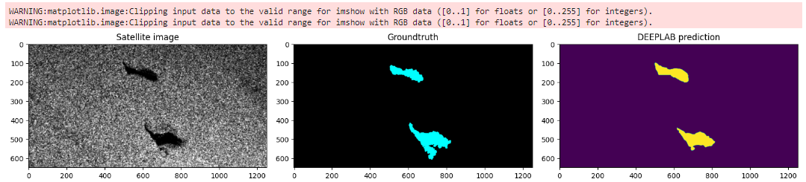
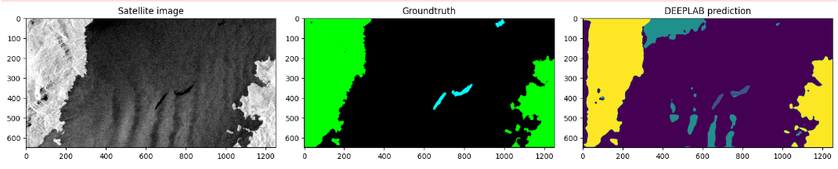
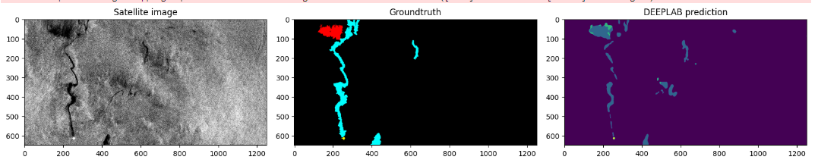
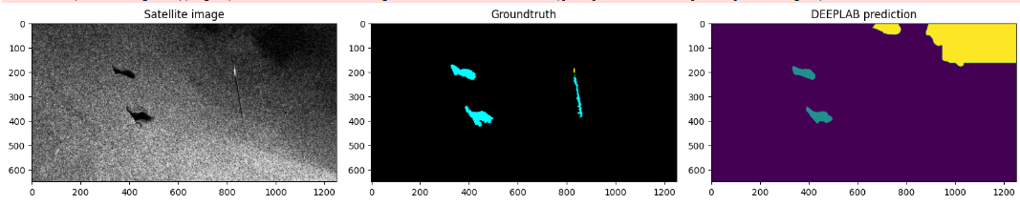
DEEPLAB: RESULTS
TR & TS = tendency
Trained Model matches to the TS
TR & TS = tendency
Trained Model matches to the TS
Processing Time: 4hours
Classification Assessment:
Overall Accuracy: 96.47%
Loss : 0.0988
Intersection over Union (IoU): 0.4
Converges
Class Imbalance
Low Mean IoU indicates that the performance for the minor classes like oil spill and lookalikes were worst.
SAR Data
Ground Truth Mask
Classification Map
SAR Data
Ground Truth Mask
Classification Map
Lookalike
Lookalike
Lookalike
Oil
Oil
Oil
ok
Confusion
Oil
Lookalike
Lookalike
Dark Spots not
Mapped in
the Mask But Detected by the Semantic Segmentation
Oil
Oil
Land
Confusion
Oil
Oil
Oil
Lookalike
Lookalike
Oil
Oil
Oil
Oil
The thinner
Oil Slick
Not Detected
Oil
Oil
Oil
Confusion
Oil
Oil
Land
Ocean
Lookalike
Ocean
Lookalike
Ocean
Lookalike
Ocean
Lookalike
Oil
Land
Ship
Oil
Land
Ship
Oil
Land
Ship
Oil
Land
Ship

Slide 13
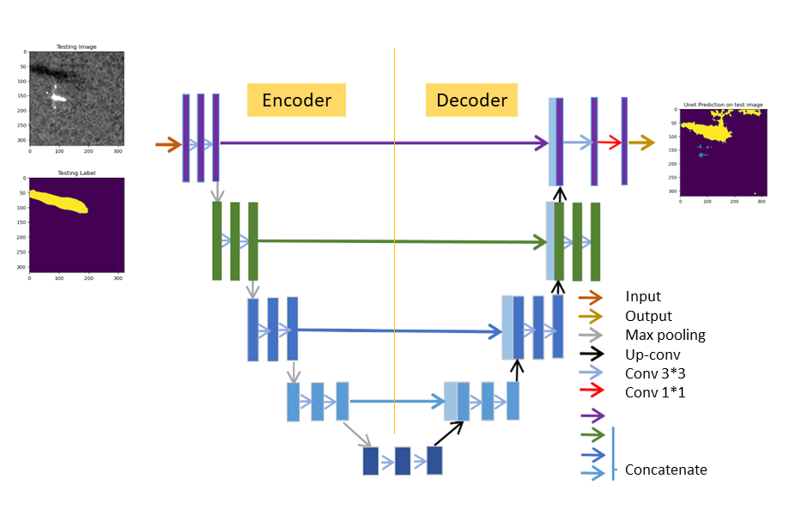
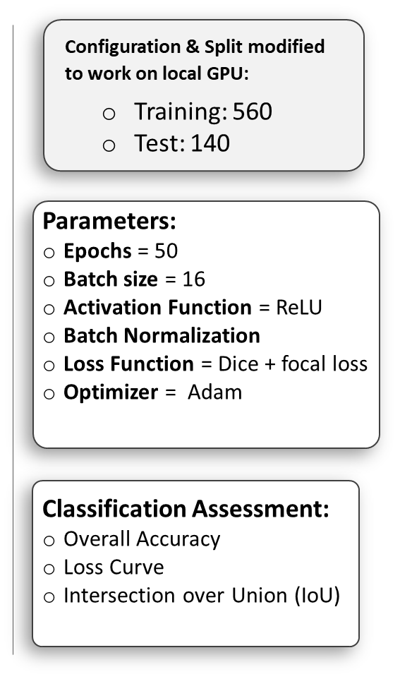
UNET: IMPLEMENTATION

Slide 14
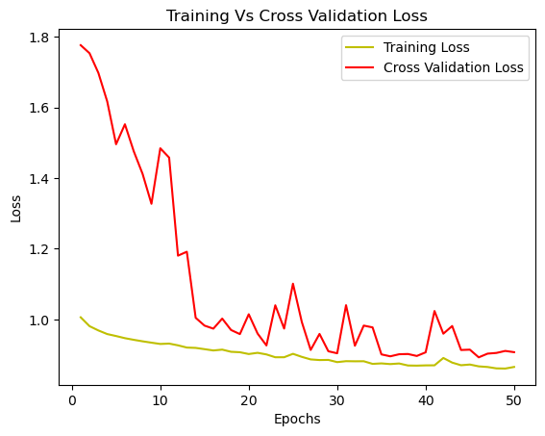
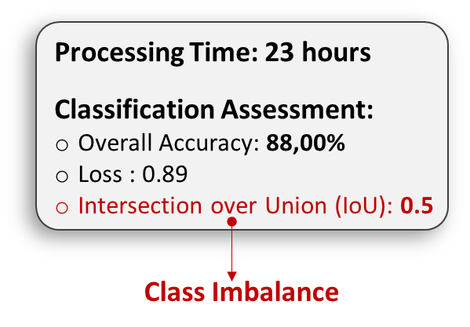
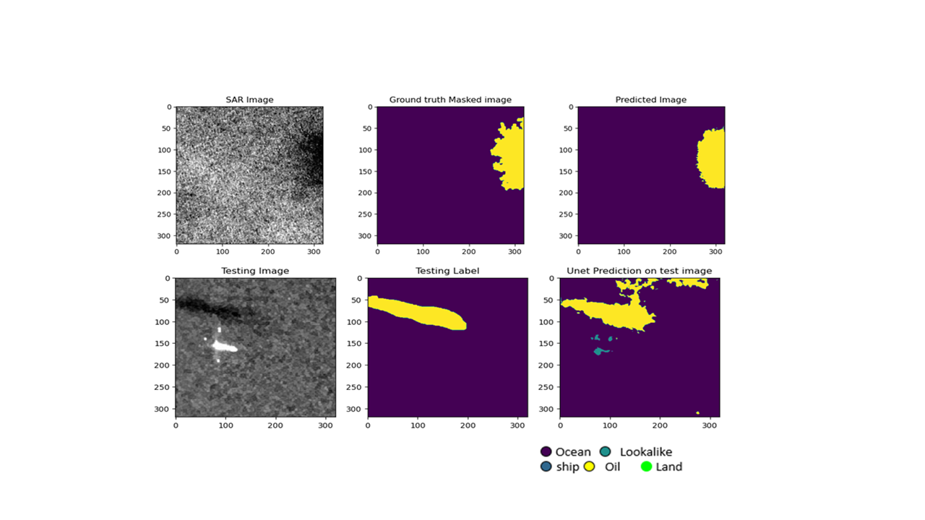
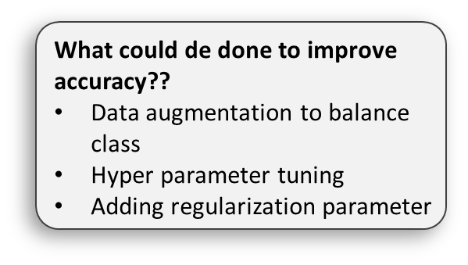
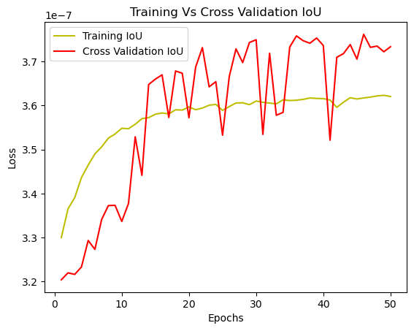
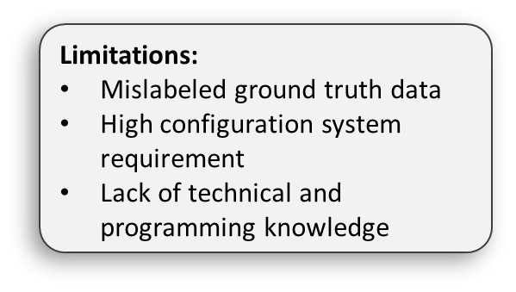
UNET: RESULTS

Slide 15
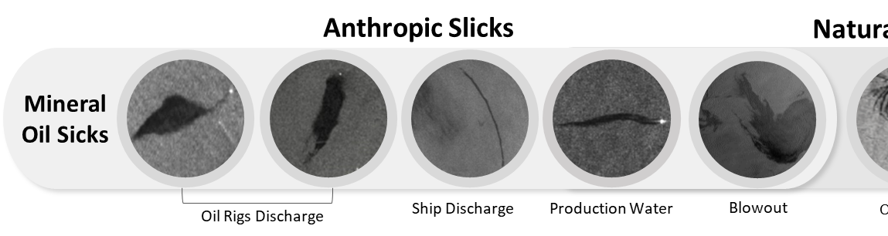
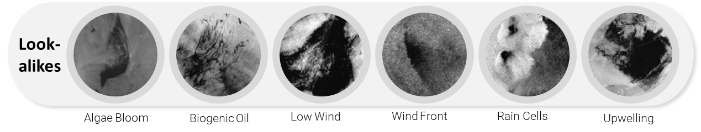
CONCLUSION: PERFORMANCE OF ML & DL
TRADITIONAL ML
DEEP LEARNING
RF
Deep
Lab
UNet
Original Data:
Overall Accuracy: 87%
Mean IOU: 0.1
Overall Accuracy: 96.47%
Loss : 0.098
Mean IoU: 0.4
Overall Accuracy: 88.00%
Loss : 0.89
Mean IoU: 0.5
HANDCRAFTED FEATURES: EDA
FEATURE MAPS: Automatic learned through the Convolutional Layers
KNOWLEDGE DRIVEN: Background and experience of the interpreter
DATA DRIVEN: Less subjective can handle SAR data automatically
FEATURES = IMAGES: Spatial context is preserved
FEATURES = FLATTENED VECTOR: Spatial context is lost
CONVOLUTIONAL LAYERS: Features in different levels of abstractions → Local and Global Context of the targets improving the Semantic Segmentation (Pixel Wise Classification)
DL Handle: Dark Spots Ambiguity and Capture Different Shapes and Dimensions

Slide 16
THANKS FOR YOUR ATTENTION

